Slide 1
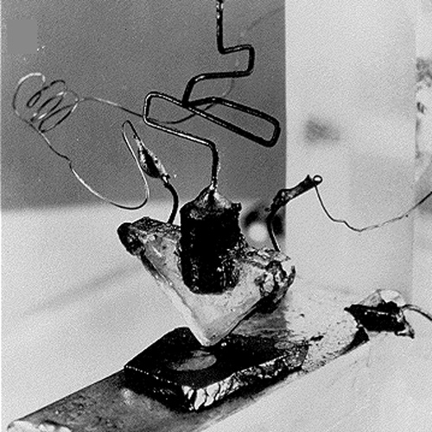
Transistor circuits & FETs
Week 6
First transistor, 1947, Bell Labs

Slide 2
Art of Electronics (AoE)
Many of the figures and in this ppt are from Horowitz and Hill’s AoE book

Slide 3
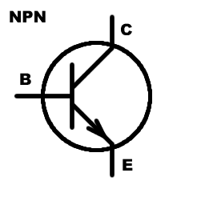

BJT Golden Rules
There are no golden rules … there are many configurations and possibilities with BJTs…
The base-emitter often acts like a diode
If V_{be} < ~0.6V then i_{c} ~ 0 and the transistor is “off”
If V_{be}~0.6-0.7V (forward biased diode), the collector-emitter conducts
Making V_{be}>0.7V will likely destroy the device quickly
If not saturated, i_{c} = h_{fe} * i_{b} = β * i_{b}
The transistor will lower its collector-emitter voltage in order to satisfy (3.) But it can’t go below V_{ce}~ 0.01-0.3V
Like diodes (e.g., LEDs), external components are generally needed to limit base and collector currents at safe (for the device) values
…

Slide 4
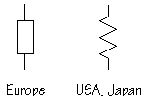
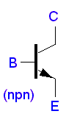
4 Important 1 transistor circuits
Fixing or floating various terminals gives various circuit properties (and a whole lot to remember and get confused about)
fixed
out
fixed
out
out
in
in
fixed
in
fixed
out
fixed
fixed
Switch
Follower
Current source (sink)
Amplifier

Slide 5
Switch
For an NPN, if V_{b}-V_{e} ~0.6V and V_{c} > V_{e} (by >~0.2V) then
I_{c} tries to equal h_{fe}I_{b} where h_{fe} is the transistor’s current gain ~ 100-400 typically
Typically Ic will saturate at a lower current, limited by the the collector source impedance
In “cutoff”, I_{b} “closes” a switch between c and e
When V_{in} = high, V_{out} → 0 the voltages invert
When I_{in} is high, I_{L} is high, the currents don’t invert
R_{L}
c
Vout
Vin
b
e

Slide 6
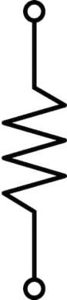
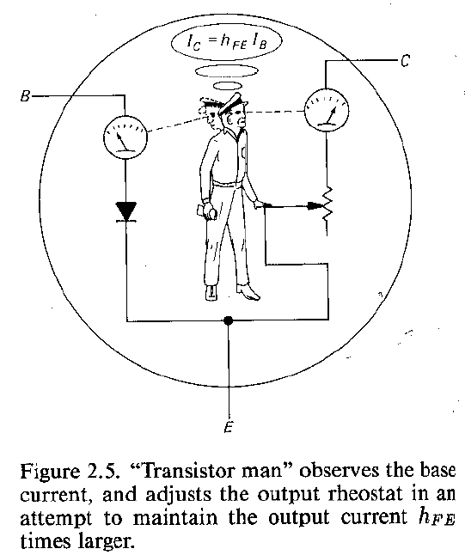
What happens in saturation?
V_{cc}
R_{c}
“Transistor man” adjusts a variable resistor that’s a voltage divider with R_{c}. Once set to its minimum value (R=V_{ce}/i_{c}), it can’t go any lower
i_{c} is now saturated at (V_{cc}-V_{ce})/R_{c}, additional increase in i_{b} cannot increase i_{c}
In saturation, the external collector circuitry (R_{c}) determines i_{c}, not h_{fe}i_{b}.
How do you feel about this model?

Slide 7
Emitter-follower
Vout = Vin - 0.6V – not very exciting, voltage gain ~1
Since we’re often interested in time-varying signals:
dVout/dt = dVin/dt → voltage gain dVout/dVin = 1
But the current gain, I_{out}/I_{in} ~hfe
Derivations and more at:
https://en.wikipedia.org/wiki/Common_collector

Slide 8
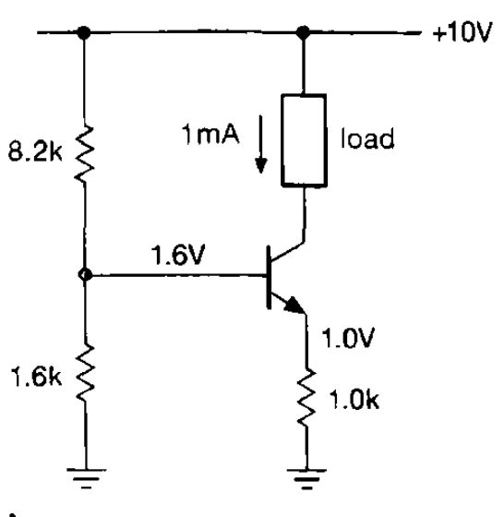
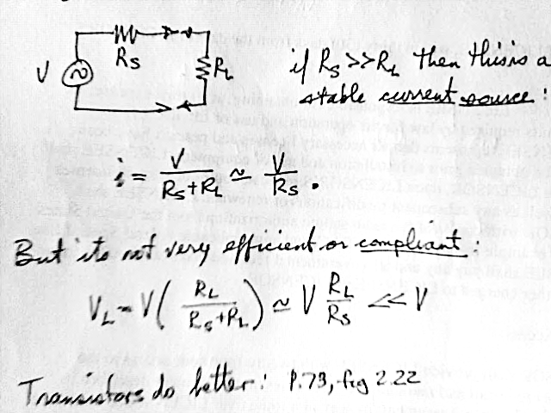
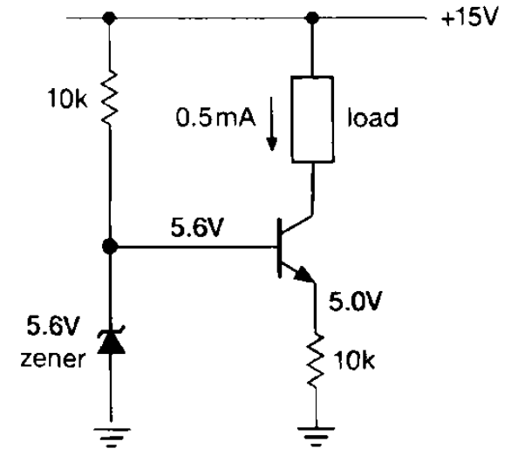
Current sources
Just as constant voltage sources (independent of R_{L}) are very useful, so are constant current sources.
Compliance refers to their ability maintain constant i as R_{L} varies
Compliance is still limited by R_{e}. Can we eliminate it?

Slide 9
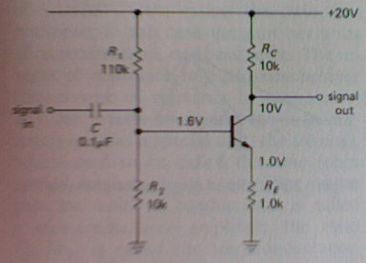
Common-emitter amplifier
A current source with resistive load is a voltage source
V_{c} = V_{cc} – i_{c}R_{c}
i_{e} = V_{e}/R_{e} ≈ V_{b}/R_{e} ≈ i_{c}
V_{c} = V_{cc} – V_{b}R_{c} / R_{e}
gain = –R_{c} / R_{e}
Note: This is an inverting amplifier. R_{E} provides negative feedback.

Slide 10
Important 1 transistor circuits
Fixing or floating various terminals gives various circuit properties (and a whole lot to remember and get confused about)
fixed
out
fixed
out
out
in
in
fixed
in
fixed
out
fixed
fixed
Switch
Follower
Current source (sink)
Amplifier

Slide 11
Some 2 transistor circuits
One of the goals of learning the “language” of electronics is to recognize circuits as building blocks of increasing complexity
You don’t read a newspaper parsing each letter or word, but instead see sentences, paragraphs, articles, sections – a hierarchy of structure
These 1-transistor circuits are sentences
The following 2 transistor circuits are analogous to paragraphs in circuits …

Slide 12
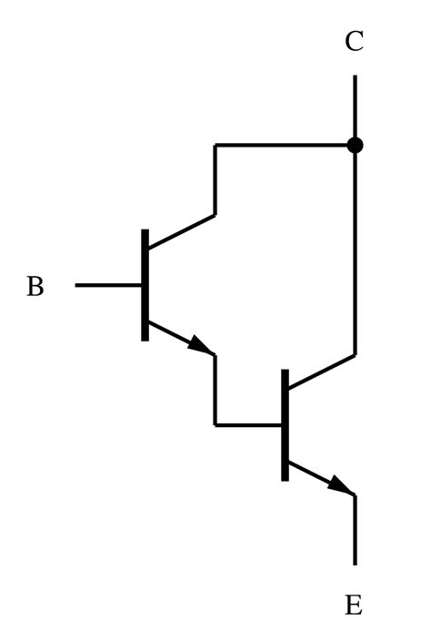
Darlington configuration
Darlingtons combine two transistors, often in one physical package
β = β₁ ∗ β₂
V_{be} = V_{be1} + V_{be2} ~1.3V
Switching time is slower
Note: FETs have nearly infinite β

Slide 13
Current mirrors
Two matched transistors with the same V_{be} should have the same i_{c}.
Transistors should be touching (or on the same die) to be at same T
Additional tricks improve mirrors …
or buy a current source IC
(Current mirrors are very common inside ICs)
=(Vcc-.6)/R
R
I_{out} = I_{REF}
Independent of V_{out}

Slide 14
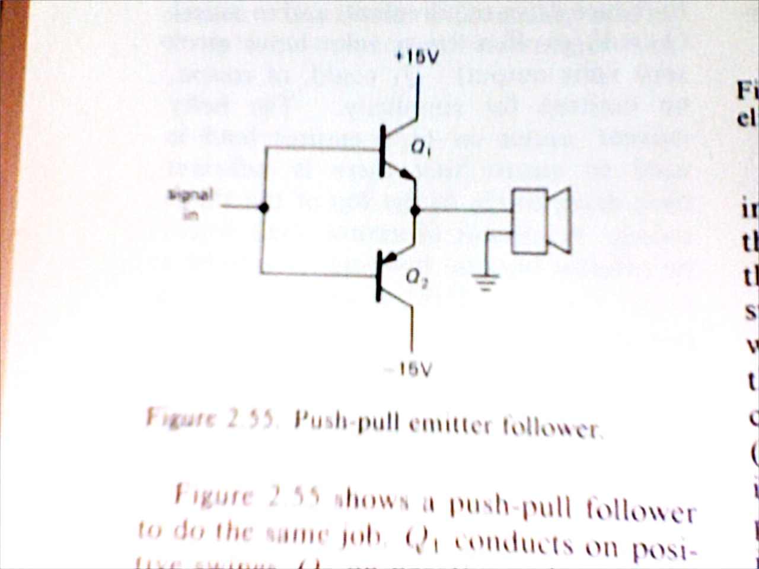
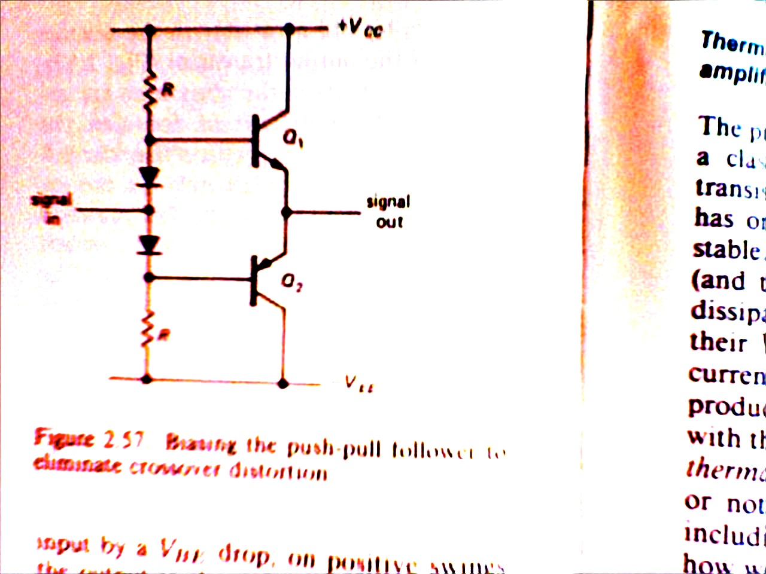
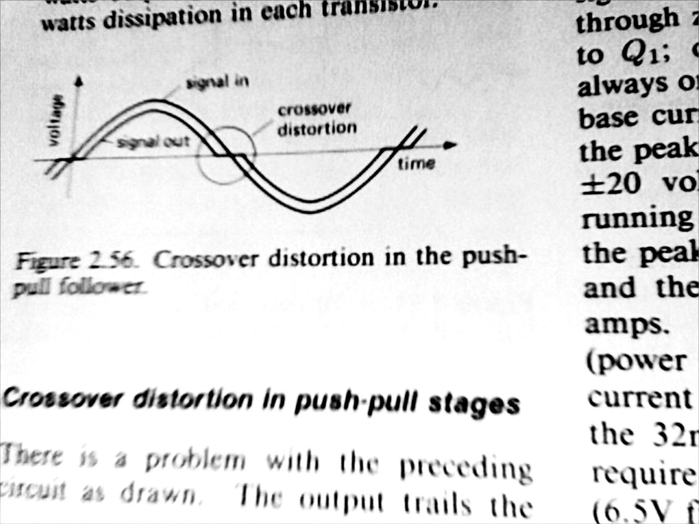
Push-pull output
NPN emitter-follower has low Z_{out}, but can’t sink current
Likewise PNP e-followers can’t source current
So put them together …
input
Z_{speaker}~8Ω
-15V

Slide 15
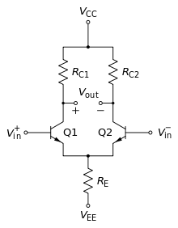
Differential amplifier
Vout = G_{diff}(V₊-V₋) + ½ G_{CM}(V₊+V₋)
These are the guts (brains?) of a lot of analog electronics because they permit amplifying small voltage differences while rejecting large common signals
Often Vcc and/or Vee are replaced by current sources
FETs in place of Q1 and Q2 can increase the input impedances to >10¹² ohms
Don’t try to build these … use integrated circuits that offer overvoltage protection circuits, temperature stability, better linearity, lower noise, etc.
But being able to recognize them as a single construct or element is helpful in deciphering schematics

Slide 16
Your comfort level “understanding” these 2-transistor circuits is likely pretty low – and that’s just fine
It will grow as needed
We’ll work through a simple (yet powerful) example later

Slide 17
BJT summary
Transistors behave distinctly in 3 regimes, “off”, where i_{b} and i_{c} ~ 0, “active”, where i_{b} and i_{c} were related by the transistor’s intrinsic property h_{fe}=i_{c}/i_{b}, and “saturated”, where i_{c} was constant, limited primarily by extrinsic circuit properties (often Vc/Rc)
A simple circuit quantified the current gain, β = h_{fe}=i_{c}/i_{b}, with 2 resistors that both limited and measured i_{b} and i_{c}
The transistor switch only requires a tiny i_{b} (that can through our fingers and body without sensation) to control (turn on and off) an LED (i_{c})

Slide 18
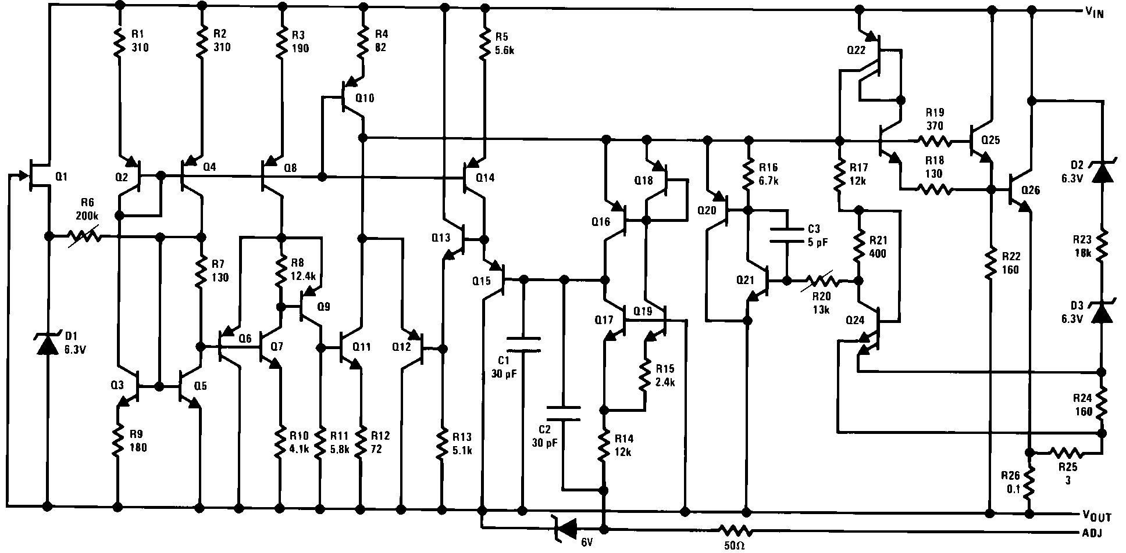
ICs are usually better
Integrated circuits usually offer far superior performance to these single transistor circuits, at virtually the same costs
Need an amplifier, use an op-amp, instrumentation amp, …
Need a voltage regulator or current source, look for ICs
Consider our <$1 LM317 – it has dozens of transistors within it make it more robust, safe, linear, …

Slide 19
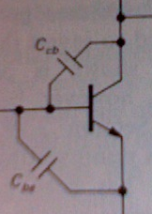
Ebers-Moll
http://en.wikipedia.org/wiki/Ebers-Moll
Ebers-Moll is a more accurate
model of the large signal
characteristics of a bipolar transistor
I_{sat} is a messy function of T, etc., so this is even uglier…
Early Effect: ΔV_{BE} =-αΔV_{CE}
And it gets even more complicated (e.g.,
Miller effect, etc…
Clever circuit designers take advantage of these
complexities, or cancel them out (e.g., with
feedback).

Slide 20
Simplest 1-transistor circuits
Fixing or floating various terminals gives various circuit properties (and a whole lot to remember and get confused about), e.g.,
fixed
out
fixed
out
R₁
i_{out} < βi_{in}
i = V_{e}/R
out
fixed
in
G = -R₁/R₂
in
in
fixed
out
Z_{out} = Z_{in}/β
R₂
fixed
fixed
Switch
Follower
Current source (sink)
Amplifier
From these 4 abstractions we built

Slide 21
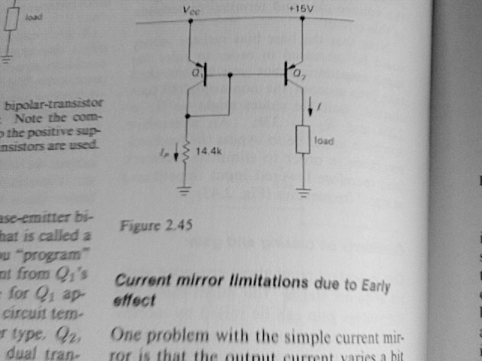
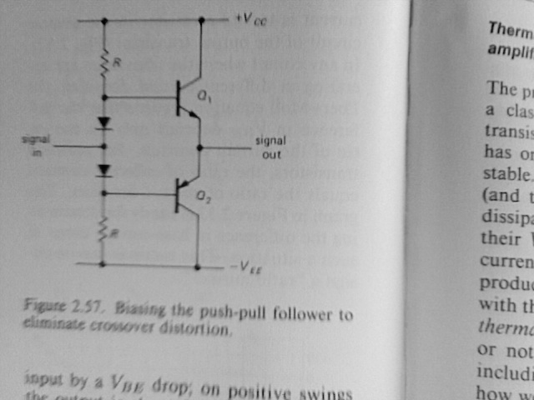
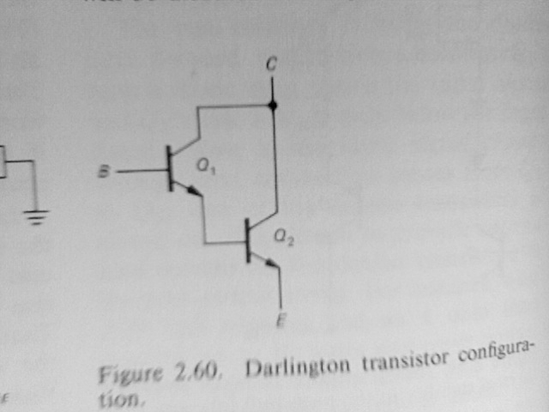
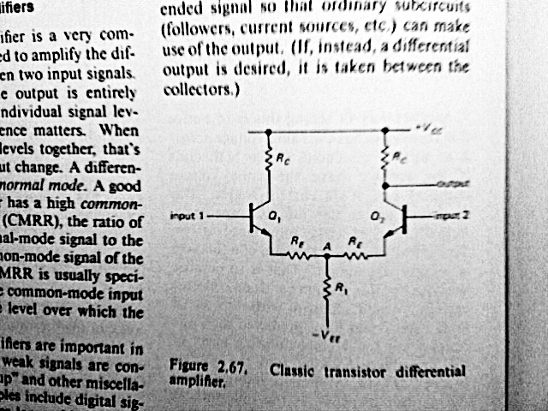
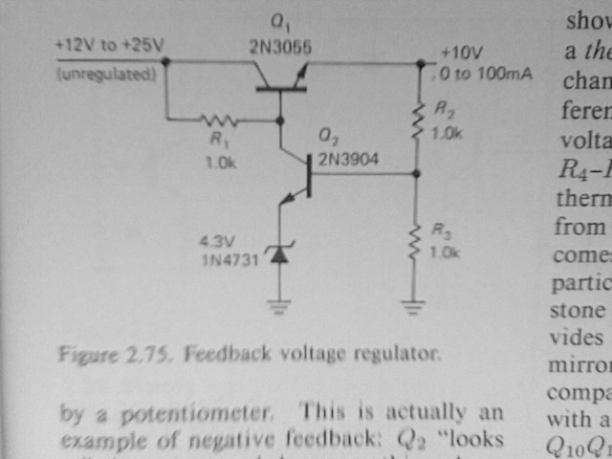
2-transistor circuits

Slide 22
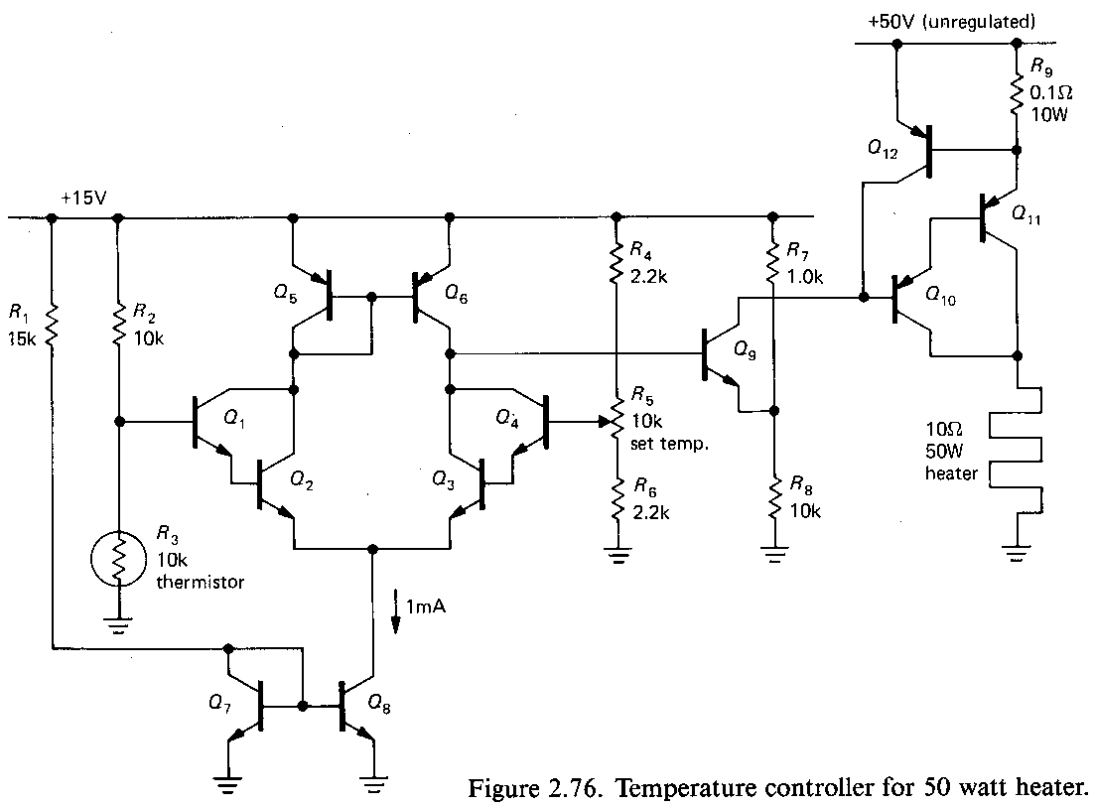
Which familiar circuits do you see?
Knowing 1 & 2 transistor circuits allows you to visually parse and understand more complex ones

Slide 23
Which familiar circuits do you see?
Voltage dividers
Switch/regulator
Knowing 1 & 2 transistor circuits allows you to quickly visually parse and understand many more complex circuits
Differential amp
Current
mirror
darlington
Current
sink
darlington
darlington
Current
mirror
Learn to see higher level, more abstract semantic elements

Slide 24
Electronics jargon and terms
Voltage – Δ in electric potential between 2 points in a circuit …
Current – flow of + charges
Impedance – a measure of opposition to current, =V/i
Reactance – imaginary part of impedance
AC/DC -- rock band
Ripple – residual AC on a DC voltage
Stiff – ability of a source to maintain its voltage under varying current (low “droop”)
Compliance – voltage range over which a current source is constant
Bypass – capacitor || a resistor to bypass AC frequencies
Amplifier – a device that changes the amplitude of a signal
Gain – ratio of output/input
Clipping – nonlinear distortion from saturation of an amplifier
Filter – a device that removes part of a signal
h_{FE} or β – BJT current gain
Biasing – lit. “to push off center” setting quiescent conditions to improve circuit behavior
Quiescent – condition or state without input (lit. quiet)
Bootstrap – getting a circuit to turn on in the proper state
Transconductance – Δi_{out}/ΔV_{in}

Slide 26
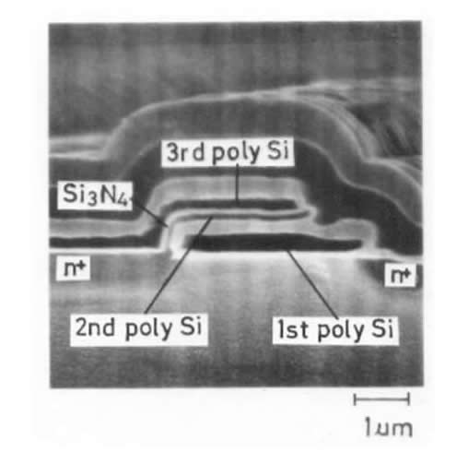
FETs
7-2

Slide 27
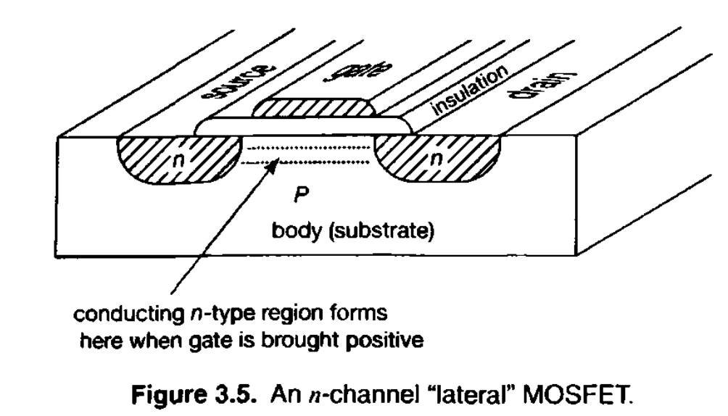
How the n-FET works
Conduction between Source and Drain is controlled by E field between Gate and substrate
Conduction can be bidirectional (no diode)
4 terminal device, though generally substrate connected to S or D
~zero DC gate current (R_{gate} ~10¹⁴ohms)

Slide 28
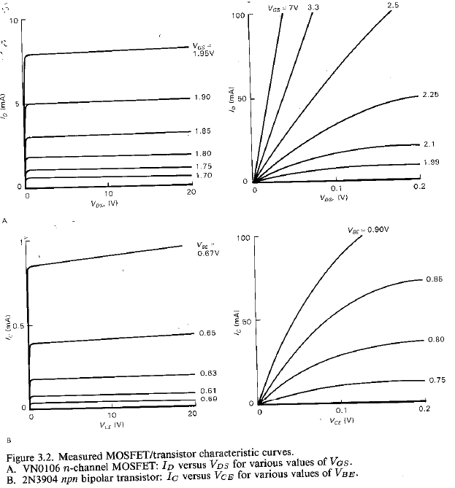
n-MOSFET vs. BJT
One gripe I have about Boysen & Kybett is they don’t include characteristic curves
Higher V_{GS} ~2V
Less Early effect
Drain formulas:
where
k α T^{-3/2}
V_{T} =“gate threshold”
~1.5-2V

Slide 29
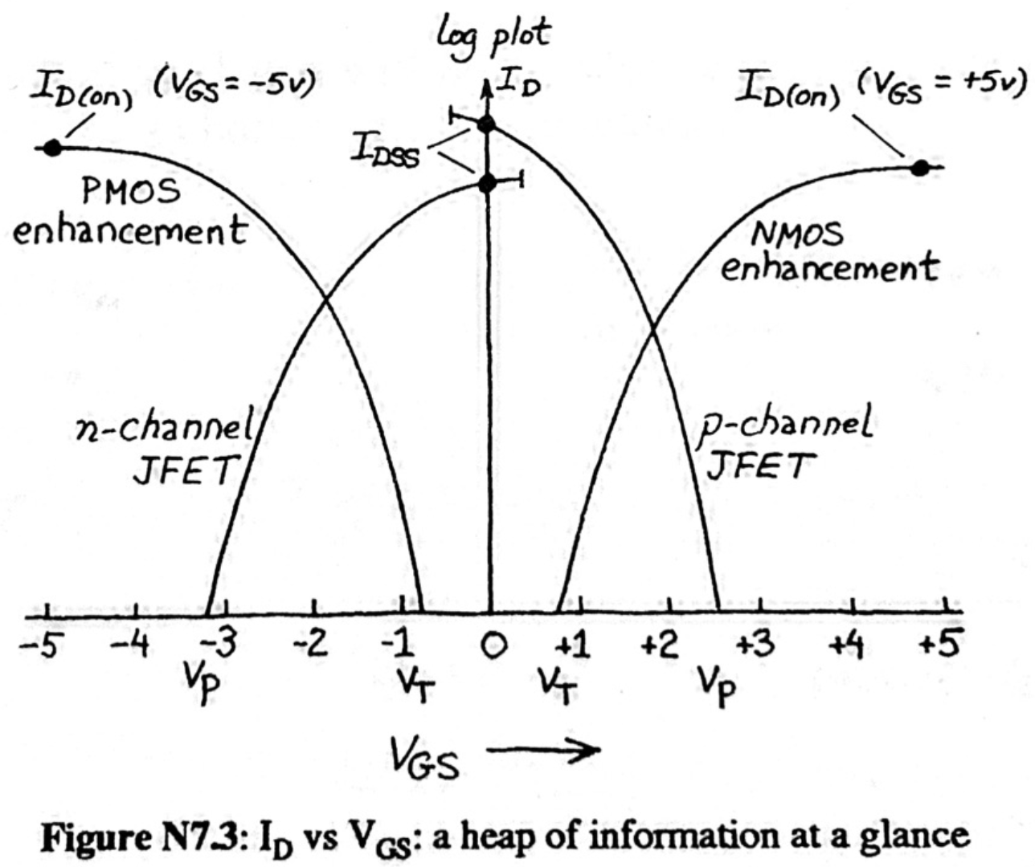
Types of FETs
N or P
x
Enhancement or depletion
x
junction or oxide
= 8 possibilities
4 are common

Slide 30
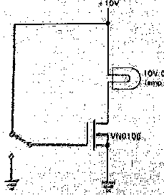
Applications
FET switch controls bulb with ~0 gate current
Most things you can do with a BJT can be done with FETs.
FET’s high Z_{in} is good … and bad
Much more sensitive to electrostatic discharge (ESD)
Fig. 3.50; pg. 170; last slide
Parasitic capacitances (Fig. 3.44) reduce Z and switching time
C_{DS} can cause “feedthrough” (Fig. 3.45) and glitches (Fig. 3.48)

Slide 31
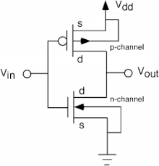
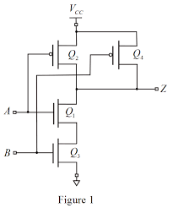
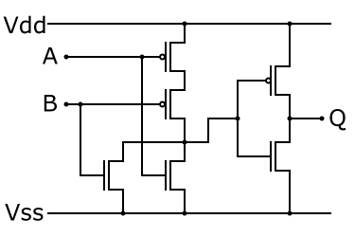
CMOS: “Digital Abstraction”
Note: FET is conducting when E = -ΔV across the gate-substrate is parallel to arrow
CMOS logic inverter (“NOT”) is push-pull configuration
CMOS NAND and OR gates
Theorem: ANY logic function can be made by combining NAND, OR, and NOT
Note: Current only flows during switching
= V_{in}
Z=AB
=A+B
open circle indicates inverter

Slide 32
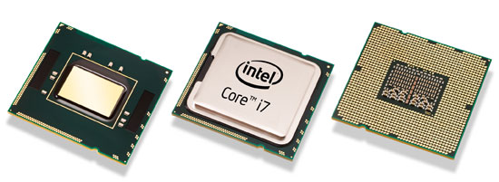


State of the art
Intel Core i7 packs 731 million transistors in 263mm² and costs $few hundred (~25k transistors per penny)
Old data, 3.2 billion on the same die now : https://en.wikipedia.org/wiki/Transistor_count

Slide 33

10/21 – M1Pro = 33.7B transistors at 5nm
M1Max = 57B
M1Ultra = 114B
6/22 – M2 Pro = 40B @ 5nm
M2 Pro Max = 67B @ 5nm
https://en.wikipedia.org/wiki/Moore%27s_law#Recent_trends

Slide 34
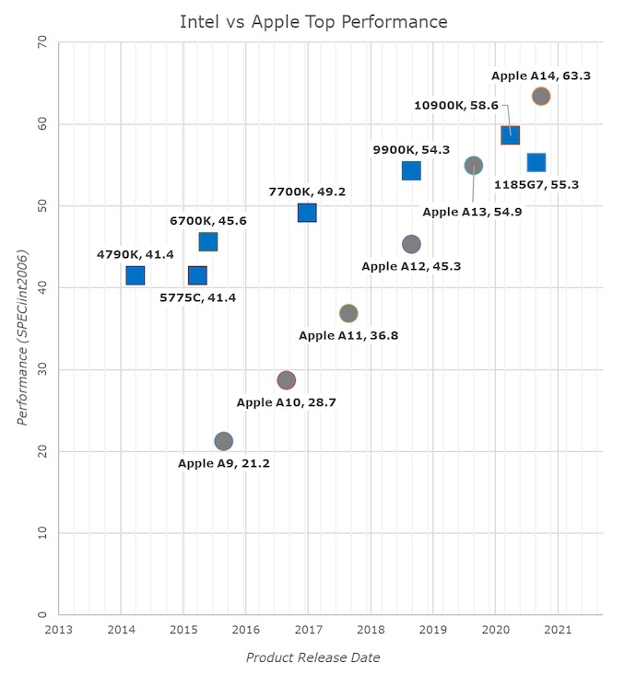
5 watts
125 watts

Slide 35
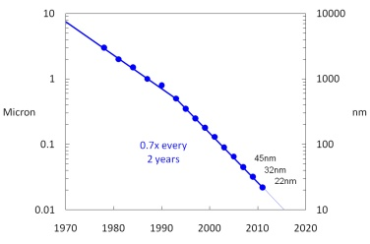
Transistor dimension evolution
Apple M1 = 5nm

Slide 36
Transistor dimension evolution
TSMC
5nm
171.3

Slide 37
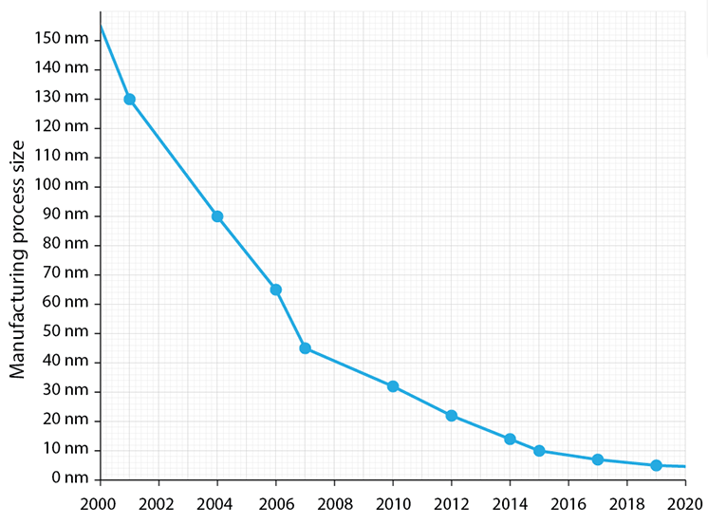
Diminishing returns

Slide 38
What’s the future??
Short term, Moore’s law is hanging on:
https://sparrowsnews.com/2020/07/13/tsmc-2nm-process/
Not just in electronics, we have to expect the future won’t be like the past …
Change can occur smoothly or in jumps …
We live in interesting times …

Slide 39
ESD techniques
FETs design makes them extremely sensitive to static electricity
Discharge from your finger on a gate can easily and invisibly destroy the device
Always discharge static electricity from your body and tools through a low Z ground (and avoid charging up)
Keep a hand touching the chassis
Touch chassis before touching parts
Keep parts in conductive bags, conductive foam, or tin foil
Use grounded soldering iron and solder (Note: float iron if soldering “hot” circuits.
Wear a grounded wrist strap
Be extra careful when the Santa Ana winds are blowing
…

Slide 40
Wrap up
FET’s can do what BJTs do, and in some ways do it better
While BJTs are common as discrete devices, FETs and CMOS in particular dominate very large scale integrated circuits (VLSI)
CMOS is very energy-efficient because it only draws current during switching
This is the sinew of all our CPUs, GPUS, and computers, and whole families of integrated circuits
Welcome to the digital abstraction: CMOS FETs in 2 saturation states representing Boolean logic states of 0 and 1
Use care to eliminate ESD in FETs

Slide 41
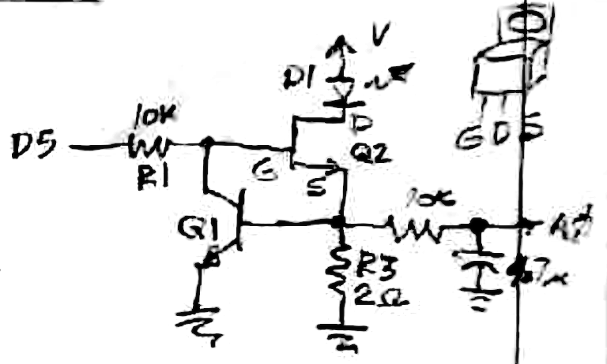
Feedback LED regulator
Feedback is one the most important concepts in electronics
D5 connects to an Arduino PWM output, which turns on the MOSFET Q2 when V_{G} >~2.5V
Turning on Q2 makes R_{DS} <~ 0.8Ω resulting in a current through the LED D1 and R3.
When i_{D1} ~ 0.6V/R3, the BJT Q1 begins conducting, pulling current from D5 through R1, thereby lowering V_{G} → V_{D5} - i_{c}*10k.
When V_{G} drops to ~2.5V, Q2 increases its R_{DS} lowering i_{D1 …}
Stability is achieved via this negative feedback for i_{D1} ~ 0.6V/2Ω ~ 300mA (this is a high-power LED).
Questions:
What do the 10k and 4.7uf on right side do?
Why didn’t V (at the top) matter?
Notes:
What does each component do?

Slide 42
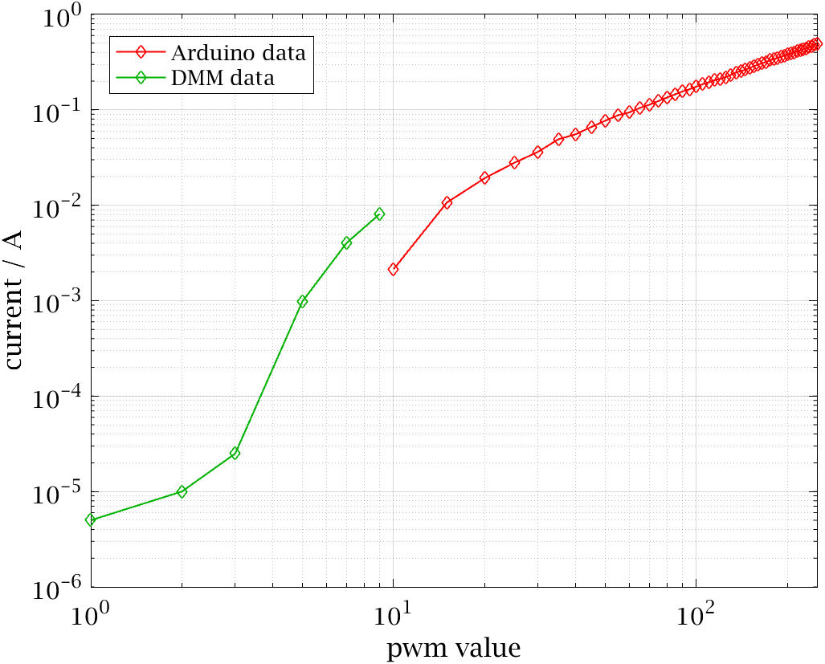
Feedback current regulator
Arduino program swept through PWM values, measuring average current on A0
A0 < 1 ADU for PWM < 10, so I measured by hand, with a 4.5-digit DMM
→ Able to vary LED current from ~ 5μA – 500mA with PWM = 1-255!!
Notes:
What does each component do?

Slide 43
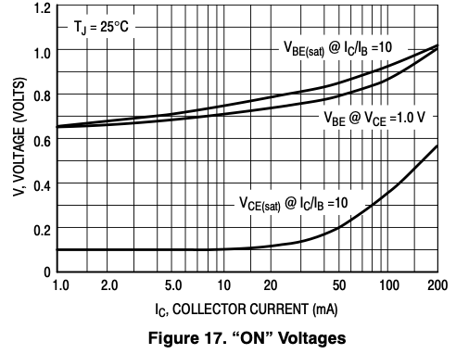
Reflections …
Like with an LED, always use a series resistor (or other mechanism) to limit a BJT’s base current
That resistor also enables easy measurement of i_{b}
You can’t easily tell the state of the transistor by measuring base voltage … E.g., for the 2N3904, V_{BE} hardly changes (~.65-.7) as Ic changes from 1-10mA
BJT’s are current devices: i_{B} controls i_{C}
External Rc often limits i_{C} < h_{fe}i_{B}
FETs are controlled by gate voltage; gate current is practically zero

Slide 44
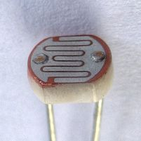
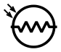
CdS photoresistors
Among your components are some CdS photoresistors¹
Create an LED nightlight powered by 10V that turns on in the dark and stays off in the light
Characterize the CdS resistor using your ohmmeter (multimeter on ohms scale), and observing how its resistance changes with light
A transistor switch turns on when V_{b} ~ 0.65V (measure it, since i_{b} = 0 for V_{be} < the diode’s V_{f})
Design and validate the circuit with a CdS photoresistor to achieve the desired transistor switching behavior: LED off in light, on in dark
Hints: 1) it maybe easier to first make the opposite – LED turns on with light; 2) Voltage divider equation
¹ https://en.wikipedia.org/wiki/Photoresistor

Slide 45
What next?
Automate control of the LM317
So the Arduino can effectively turn the R2 knob
We will control the LM317 voltage via our keyboard and Matlab scripts
Matlab will communicate directly with the Arduino
Explore AC … time varying voltages and signals, for the rest of the semester
Build a function generator
Construct an oscilloscope (in software) to display time-varying signals
Automate control of function generator’s frequency
We’ll mix up 1 and 2 … we’ll need some AC concepts to do 1.

